Slide 1
Learning Big Data
Aditya Konda
Big Data Engineer

Slide 2
Content
Hive
Challenges faced by Data Analysts
Hive Key Principles
Data Model
Tables
Partitions
Buckets
Hive Architecture
Hive QL

Slide 3
Content
Pig
Key properties
Why pig
Pig script
Equivalent java MR code
Pig script work-flow
Pig vs hadoop

Slide 4
Content
Pig
committers of pig and user of Pig
pig use-cases
components of pig
pig execution mode
pig data-types
pig commands
Pig Architecture

Slide 5

Challenges faced by Data Analysts
Data Explosion
- TBs of data generated everyday
Solution
HDFS to store data and Hadoop Map-Reduce framework to parallelize processing of Data

Slide 6
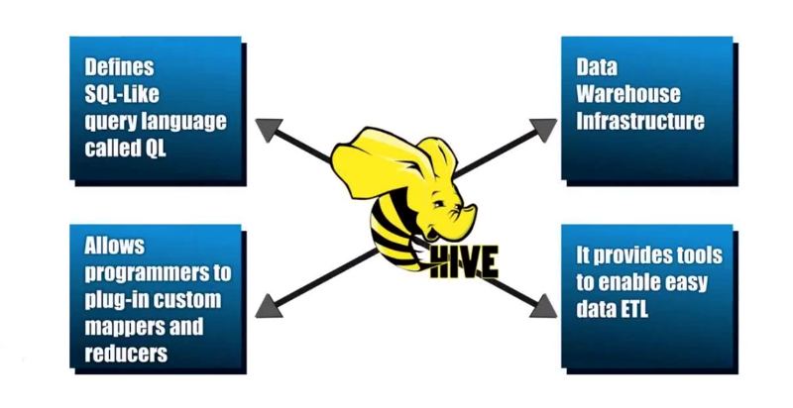
Hive Key Principles
Notes:
Data Warehouse - A system used for reporting and data analysis. DWs are central repositories of integrated data from one or more disparate sources
ETL – process of extracting data from source and bringing it into data warehouse. Extract Transform and Load.

Slide 7
Hive Data Model
Data in Hive organized into :
Tables
Partitions
Buckets

Slide 8
Hive Data Model - Tables
Each table has a corresponding directory in HDFS
Data serialized and stored as files within that directory
Users can specify custom serialization –deserialization schemes (SerDe’s)

Slide 9
Hive Data Model - Partitions
Each table can be broken into partitions
Partitions determine distribution of data within subdirectories
Example
CREATE_TABLE Sales (sale_id INT, amount FLOAT) PARTITIONED BY (country STRING, year INT, month INT)
So each partition will be split out into different folders like
Sales/country=US/year=2012/month=12

Slide 10
Hierarchy of Hive Partitions
/hivebase/Sales
/country=US
/country=CANADA
/year=2012
/year=2012
/year=2015
/year=2014
/month=12
/month=11
/month=11
File
File
File
Notes:
Partitioned tables can be created using the PARTITIONED BY clause. A table can have one or more partition columns and a separate data directory is created for each distinct value combination in the partition columns. Further, tables or partitions can be bucketed using CLUSTERED BY columns, and data can be sorted within that bucket via SORT BY columns. This can improve performance on certain kinds of queries.

Slide 11
Hive Data Model - Buckets
Data in each partition divided into buckets
Based on a hash function of the column
H(column) mod NumBuckets = bucket number
Each bucket is stored as a file in partition directory

Slide 12
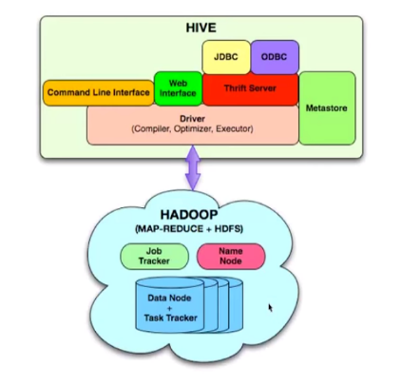
Hive Architecture
Externel Interfaces: CLI, WebUI, JDBC, ODBC programming interfaces
Thrift Server: Cross Language service framework
Metastore: Meta data about the Hive tables, partitions
Driver: Brain of Hive! Compiler, Optimizer and Execution engine

Slide 13
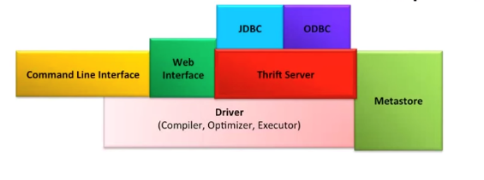
Hive Thrift Server
Framework for cross language services
Server written in Java
Support for clients written in different languages
JDBC(java), ODBC(c++), php, perl, python scripts

Slide 14
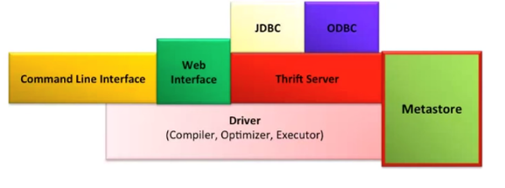
Metastore
Stored in RDBMS/local. Objects of Metastore
Database - Namespace of tables
Table - list of columns, types, owner, storage, SerDes
Partition – Partition specific column, Serdes and storage
Notes:
Metadata for table contains list of columns and their types, owner, storage and SerDe information. It can also contain any user supplied key and value data; this facility can be used to store table statistics in the future. Storage information includes location of the ta- ble’s data in the underlying file system, data formats and bucketing information. SerDe metadata includes the implementation class of serializer and deserializer methods and any supporting information required by that implementation.
Hive now records the schema version in the metastore database and verifies that the metastore schema version is compatible with Hive binaries that are going to accesss the metastore. Note that the Hive properties to implicitly create or alter the existing schema are disabled by default. Hive will not attempt to change the metastore schema implicitly. When you execute a Hive query against an old schema, it will fail to access the metastore.

Slide 15
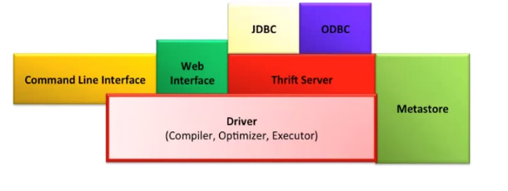
Hive Driver
Driver - Maintains the lifecycle of HiveQL statement
Query Compiler – Compiles HiveQL in a DAG of map reduce tasks
Executor - Executes the tasks plan generated by the compiler in proper dependency order. Interacts with the underlying Hadoop instance

Slide 16
Compiler
Converts the HiveQL into a plan for execution
Plans can
Metadata operations for DDL statements e.g. CREATE, HDFS operations e.g. LOAD
Semantic Analyzer: checks schema information, type checking, implicit type conversion, column verification
Optimizer: Finding the best logical plan e.g. Combines multiple joins in a way to reduce the number of map reduce jobs, Prune columns early to minimize data transfer
Physical plan generator: creates the DAG of map-reduce jobs
Notes:
These repartition operators mark the boundary between the map phase and a reduce phase during physical plan generation.

Slide 17
HiveQL
DDL :
CREATE DATABASE
CREATE TABLE
ALTER TABLE
SHOW TABLE
DESCRIBE
DML:
LOAD TABLE
INSERT
QUERY:
SELECT
GROUP BY
JOIN
MULTI TABLE INSERT
Notes:
The EXTERNAL keyword lets you create a table and provide a LOCATION so that Hive does not use a default location for this table. This comes in handy if you already have data generated. When dropping an EXTERNAL table, data in the table is NOT deleted from the file system.

Slide 18

Apache Pig

Slide 19
Pig
High level data flow language for exploring very large datasets.
Provides an engine for executing data flows in parallel on Hadoop.
Compiler that produces sequences of MapReduce programs
Operates on files in HDFS
Metadata not required, but used when available

Slide 20
Pig-Key Properties
Ease of programming: Trivial to achieve parallel execution of simple and parallel data analysis tasks
Optimization opportunities: Allows the user to focus on semantics rather than efficiency
Extensibility: Users can create their own functions to do special-purpose processing

Slide 21
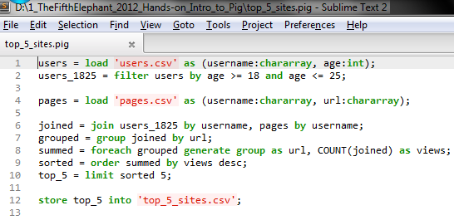
Why Pig?

Slide 22
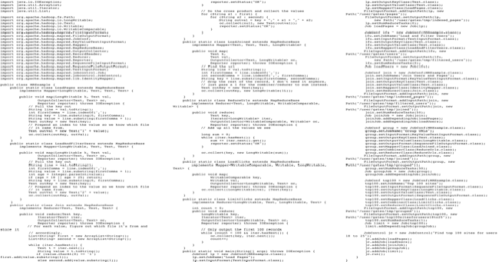
Equivalent Java MapReduce Code

Slide 23
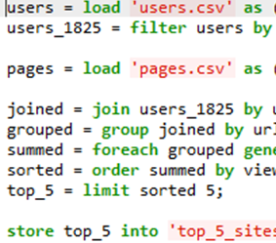
Load Users
Load Pages
Filter by Age
Join on Name
Group on url
Count Clicks
Order by Clicks
Take Top 5
Save results

Slide 24
Pig vs Hadoop
5% of the MR code.
5% of the MR development time.
Within 25% of the MR execution time.
Readable and reusable.
Increases programmer productivity.
No Java expertise required.

Slide 25









Committers of Pig

Slide 26





Who is using Pig?

Slide 27
Pig use cases
Processing many Data Sources
Data Analysis
Text Processing
Structured
Semi-Structured
ETL
Machine Learning
Advantage of Sampling in any use case

Slide 28
Components of Pig
Pig Latin
Submit a script directly
Grunt
Pig Shell
PigServer
Java Class similar to JDBC interface

Slide 29
Pig Execution Modes
Local Mode
Need access to a single machine
All files are installed and run using your local host and file system
Is invoked by using the -x local flag
pig -x local
MapReduce Mode
Mapreduce mode is the default mode
Need access to a Hadoop cluster and HDFS installation.
Can also be invoked by using the -x mapreduce flag or just pig
pig
pig -x mapreduce

Slide 30
Pig Simple Datatypes
Simple Type | Description | Example
int | Signed 32-bit integer | 10
long | Signed 64-bit integer | Data: 10L or 10l Display: 10L
float | 32-bit floating point | Data: 10.5F or 10.5f or 10.5e2f or 10.5E2F Display: 10.5F or 1050.0F
double | 64-bit floating point | Data: 10.5 or 10.5e2 or 10.5E2 Display: 10.5 or 1050.0
chararray | Character array (string) in Unicode UTF-8 format | hello world
bytearray | Byte array (blob)
boolean | boolean | true/false (case insensitive)

Slide 31
Pig Complex Datatypes
Type | Description | Example
tuple | An ordered set of fields. | (19,2)
bag | An collection of tuples. | {(19,2), (18,1)}
map | A set of key value pairs. | [open#apache]

Slide 32
Pig Commands
Statement | Description
Load | Read data from the file system
Store | Write data to the file system
Dump | Write output to stdout
Foreach | Apply expression to each record and generate one or more records
Filter | Apply predicate to each record and remove records where false
Group / Cogroup | Collect records with the same key from one or more inputs
Join | Join two or more inputs based on a key
Order | Sort records based on a Key
Distinct | Remove duplicate records
Union | Merge two datasets
Limit | Limit the number of records

Slide 33
Pig Diagnostic Operators
Statement | Description
Describe | Returns the schema of the relation
Dump | Dumps the results to the screen
Explain | Displays execution plans.
Illustrate | Displays a step-by-step execution of a sequence of statements

Slide 34
Architecture of Pig
Grunt (Interactive shell)
PigServer (Java API)
PigContext
Parser (PigLatin→LogicalPlan)
Optimizer (LogicalPlan → LogicalPlan)
Compiler (LogicalPlan → PhysicalPlan → MapReducePlan)
ExecutionEngine
Hadoop

Slide 35
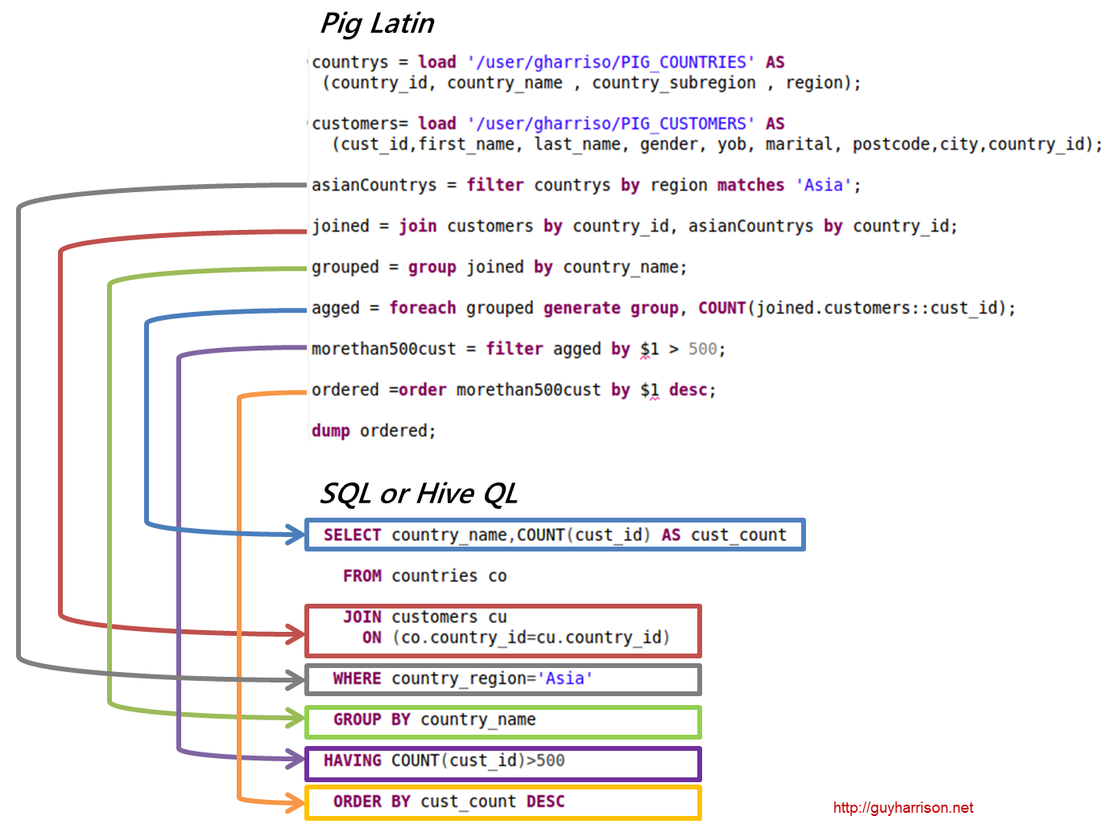
Pig Latin vs SQL

Slide 36

Pig vs Hive
Feature | Pig | Hive
Language | PigLatin | SQL-like
Schemas / Types | Yes (implicit) | Yes (explicit)
Partitions | No | Yes
Server | No | Optional (Thrift)
User Defined Functions (UDF) | Yes (Java, Python, Ruby, etc) | Yes (Java)
Custom Serializer/Deserializer | Yes | Yes
DFS Direct Access | Yes (explicit) | Yes (implicit)
Join/Order/Sort | Yes | Yes
Shell | Yes | Yes
Streaming | Yes | Yes
Web Interface | No | Yes
JDBC/ODBC | No | Yes (limited)
Source:http://www.larsgeorge.com/2009/10/hive-vs-pig.html

Slide 37
References
Hive Introduction
Hive Metastore
https://hive.apache.org/
https://cwiki.apache.org/confluence/display/Hive/Presentations
https://developer.yahoo.com/blogs/hadoop/comparing-pig-latin-sql-constructing-data-processing-pipelines-444.html
http://www.qubole.com/blog/big-data/hive-best-practices/

Slide 38


